Slide 1

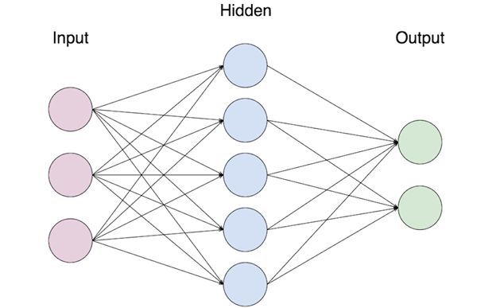

CS489 Final Brief
CDT Tyler Reece
Mr. Kyle King

Slide 2
Agenda
Problem Overview
Motivation
Summary of Research and Results
Final Model Process Overview
Demo
Conclusion
Suggestions for Future Work
Questions

Slide 3
Problem Overview
Many secondary “junk connections” for every primary one
Primary: a request that results in the genesis of a browsing session
google.com, facebook.com, wikipedia.org
Secondary: a request that supports a browsing session
ads.doubleclick.google.com, cdn.cnn.com, e9428.b.akamaiedge.net
Secondary connections can be things such as:
Images, JavaScript, video, ads, custom fonts, CDNs, third party analytics
All relatively scarce just a decade ago

Slide 4
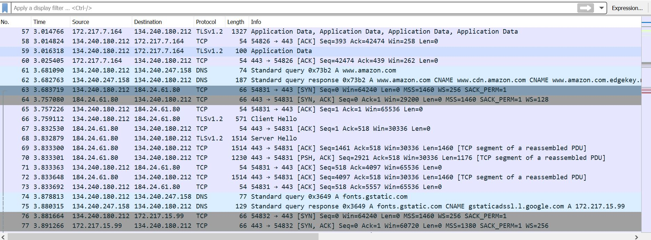
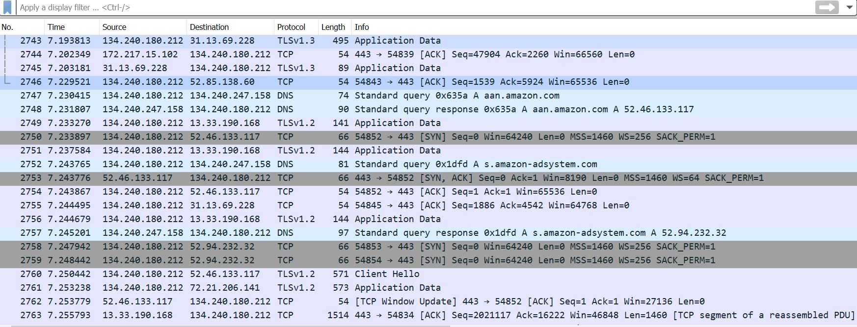
Original request
Fonts
Ads

Slide 5
Motivation
Networks getting exponentially more complicated
Network analysis tools falling behind
WireShark, TShark, Snort
Traditional tools focusing on the specifics, not macro trends
Difficult to answer basic questions about a session
How many websites were visited? Which one was visited the longest? Which one had the most traffic?
Separate what’s important from what’s not
Understand the genesis of a single connection
Big Data + lots of features + uncertain relationships → Machine Learning

Slide 6
Initial Attempt: Hand Label all Packets (Supervised Learning)
Initially attempted to hand label TCP connections from a self-generated dataset
Several problems:
Which TCP packets to label? Initial TCP connection (3-way handshake), full exchange of data, TCP connection close, all of it?
Scalability concerns (time cost of labeling)
Repeated browsing in the same entity? i.e. clicking around on links to articles on CNN

Slide 7
Second Attempt: Unsupervised Learning
Attempted to use unsupervised learning (clustering) to group together TCP streams of similar properties
K-Means (attempts to partition observations into k distinct clusters)
Showed some results (partitioned TCP streams correctly)
Pattern matched with time stamps from dataset
Lacked a cross-validation method to verify correctness

Slide 8
Third Attempt: Supervised Learning on DNS
DNS (Domain Name Service) is a much more limited subset of network traffic
DNS packets can easily be hand labeled in a reasonable amount of time
1000 rows ~ 30 minutes
DNS queries precede the TCP connection that transfers the actual content of the web browsing session
Features easier to extract and quantify

Slide 9
Data preparation
.csv file with relevant features quantified
.csv file (only necessary data)
Labelled dataset
.pcap file
TShark
Feature Extractor (Python)
Hand Label
cdn.cnn.com?
Queries
Model
Secondary!
Classifications
Accuracy Tests

Slide 10
Demo Accuracy Test & User Input

Slide 11
Conclusion
Various models (KNN, MLP, Decision Tree, SVM) show promising results with accuracy in the 96%-98% range
Further training/testing necessary to ensure model is as correct as possible
Continued work will need to leverage a non-DNS solution (DNS encryption)
However, classifying between primary and secondary network connections using a supervised learning model is feasible and highly accurate

Slide 12
Suggestions for Future Work
Further “adversarial” testing to find weaknesses in model
Train model on larger (10,000 row) datasets
Add additional features → 99.5% or higher
Match DNS packets with their correlated TCP packets
Use this to label TCP packets automatically
Then create a model for TCP connections only
Investigate various features to classify TCP packets
Sort TCP packets by stream
Inter-packet arrival time
Integrate work into capstone project (NetGrok)
Utilize as filter to only show primary connections

Slide 13
Questions

